Slide 1

INTEGRATING LLMS INTO COMMUNICATION RESEARCH METHODS: POSSIBILITIES, ASSUMPTIONS AND RISKS
Workshop
ARC Centre of Excellence for
AUTOMATED DECISION-MAKING AND SOCIETY
Alfie Chadwick and Laura Vodden
Presented at the ADM+S 2026 Summer School
February 13, 2026
RMIT University, Melbourne

Slide 2
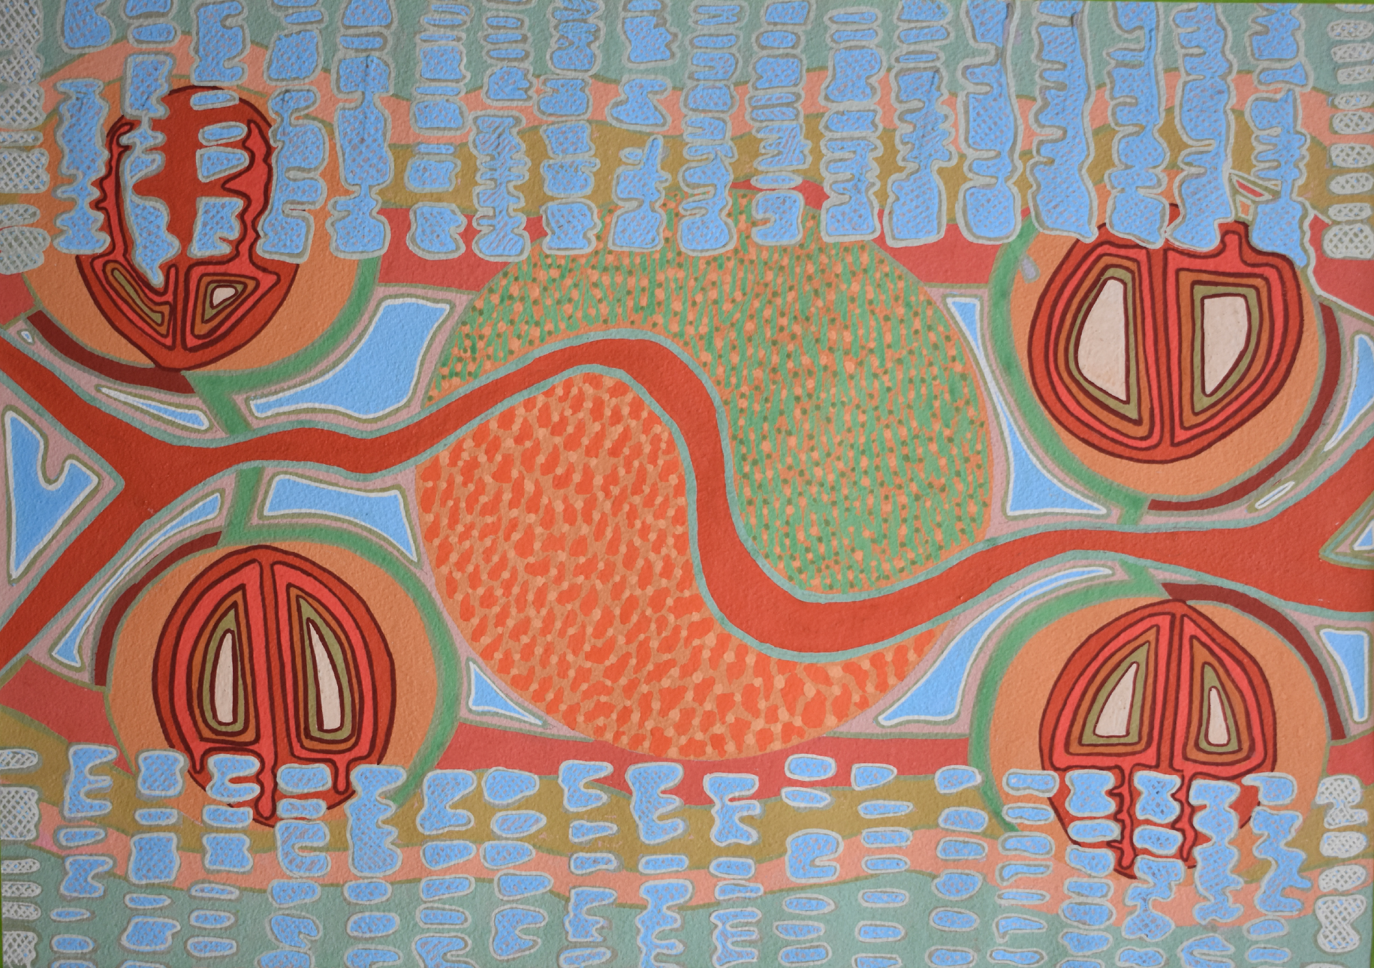
ACKNOWLEDGEMENT OF
COUNTRY
In the spirit of reconciliation, we acknowledge the Traditional Custodians of Country throughout Australia and their connections to land, sea and community. We pay our respect to their Elders past and present and extend that respect to all Aboriginal and Torres Strait Islander peoples today.

Slide 3

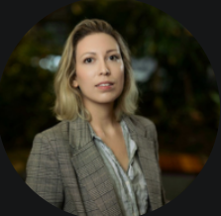

+ INTRODUCTIONS
+ OURMISSION
Alfie Chadwick (Monash Uni)
PhD Candidate
Interests:
Laura Vodden (QUT)
Data Scientist/PhD Candidate
Interests: LLM-assisted qualitative research, content analysis

Slide 4
+ TODAY’S AGENDA
+ OURMISSION
LLMS IN COMMUNICATION RESEARCH
PERTINENT QUESTIONS
USING LLMS FOR XXXXX XXXXXX
(Interactive session)
DISCUSSION AND REFLECTIONS
Key objectives: To hink about how language models can be used to answer questions you might be interested in….. refine

Slide 5
+ LLMS IN COMMUNICATION RESEARCH
+ OURMISSION
The rise of LLMs and potential for use in communications research
Limitations of LLMs
- Lack of reproducible outputs
- Bias in the training data
Strengths of LLMs
- xx
- xx

Slide 6
+ LLMS IN COMMUNICATION RESEARCH
+ OURMISSION
Existing uses
- Text classification
- Information extraction
- Text summarisation
- Content coding
Current best practices
- As assistants to humans
- Comparison against human-generated gold standards
- Outputs subject to agreement metrics to evaluate accuracy, reliability, etc.

Slide 7
+ PERTINENT QUESTIONS
+ OURMISSION
- What is the role of the human researcher in LLM-assisted research?
- What is the impact of embedded bias in these models?
- How can we ensure the validity of LLM-assisted research?
Keep in mind for the rest of the session: What are our assumptions, what are the possibilities, and what are the risks?

Slide 8
+ INTERACTIVE SESSION
+ OURMISSION
Shortened URL to Google Colab notebook

Slide 9
+ DISCUSSION AND REFLECTION
+ OURMISSION
What is the role of the human researcher in LLM-assisted research?
What is the impact of embedded bias in these models?
How can we ensure the validity of LLM-assisted research?
What are our assumptions, what are the possibilities, and what are the risks?

Slide 10







Thank you for participating!
admscentre.org.au

